Slide 1


UNIT - IV
Analysing data with Hadoop – Scaling – Streaming

Slide 2
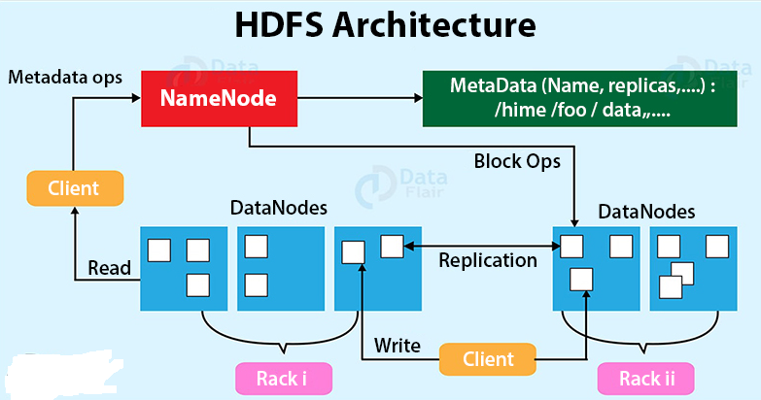
HDFS Architecture

Slide 3
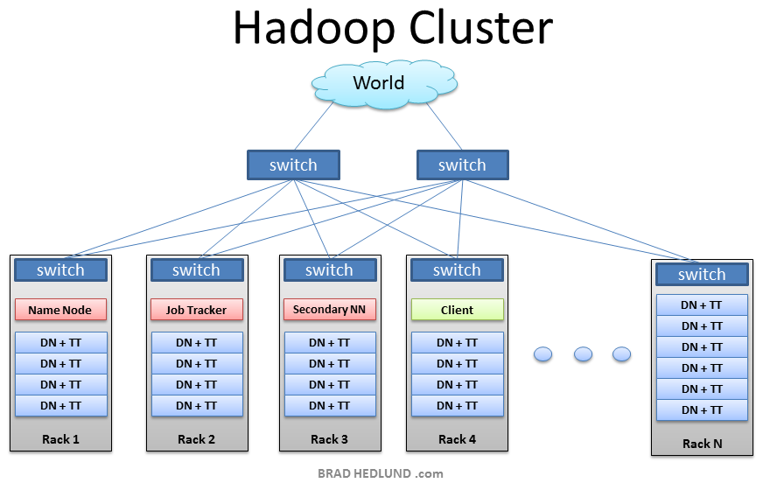
Hadoop Cluster
Hadoop Distributed File System follows the master-slave architecture.
Each cluster comprises a single master node and multiple slave nodes.

Slide 4
Hadoop HDFS Data Read Operation

Slide 5
Hadoop HDFS Data Read Operation
Client opens the file it wishes to read by calling open() on the FileSystem object.
DistributedFileSystem calls the namenode using RPC to determine the locations of the blocks for the first few blocks in the file.
DistributedFileSystem returns a FSDataInputStream to the client for it to read data from.
FSDataInputStream, thus, wraps the DFSInputStream which manages the datanode and namenode I/O.
Client calls read() on the on the FSDataInputStream object.
DFSInputStream which has stored the datanode addresses then connects to the closest datanode for the first block in the file.

Slide 6
Hadoop HDFS Data Read Operation
Data is streamed from the datanode back to the client, as a result client can call read() repeatedly on the stream.
When the block ends, DFSInputStream will close the connection to the datanode and then finds the best datanode for the next block.
If the DFSInputStream encounters an error while communicating with a datanode, it will try the next closest one for that block.
When the client has finished reading the data, it calls close() on the stream.

Slide 7
Hadoop HDFS Data Read Operation
The DFSInputStream, which contains the addresses for the first few blocks in the file, connects to the closest DataNode to read the first block in the file.
When the client has finished reading the data, it calls close() on the FSDataInputStream.

Slide 8
Hadoop HDFS Data Write Operation

Slide 9
Hadoop HDFS Data Write Operation
The HDFS client sends a create request on DistributedFileSystem APIs.
DistributedFileSystem makes an RPC call to the namenode to create a new file in the file system’s namespace.
The namenode performs various checks to make sure that the file doesn’t already exist
When these checks pass, then only the namenode makes a record of the new file;
otherwise, file creation fails and the client is thrown an IOException.
The DistributedFileSystem returns a FSDataOutputStream for the client to start writing data.
The list of datanodes form a pipeline, and here we’ll assume the replication level is three, so there are three nodes in the pipeline.

Slide 10
Hadoop HDFS Data Write Operation
The DataStreamer streams the packets to the first datanode in the pipeline.
which stores the packet and forwards it to the second datanode in the pipeline.
Similarly, the second datanode stores the packet and forwards it to the third (and last) datanode in the pipeline.
DFSOutputStream also maintains an internal queue ack queue.
The ack data packets are removed from the queue.
When the client has finished writing data, it calls close() on the stream.
This action flushes all the remaining packets to the datanode pipeline and waits for acknowledgments

Slide 11
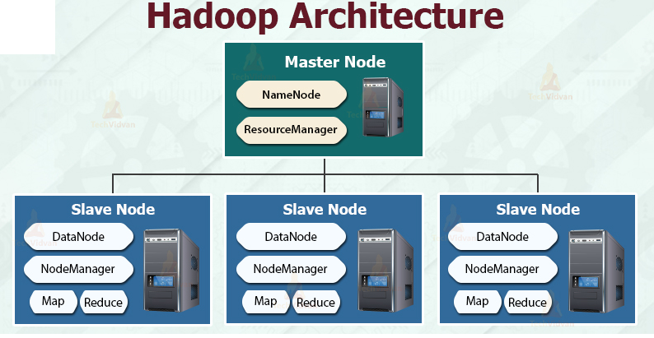
Hadoop framework

Slide 12
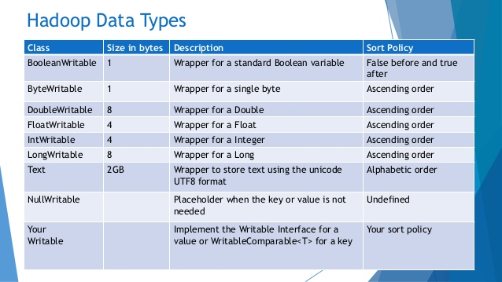
Hadoop data types

Slide 13
Hadoop data types : Serialization
Serialization is the process of converting object data into byte stream data.
Deserialization:
Deserialization is the reverse process of serialization and converts byte stream data into object data for reading data from HDFS.
Hadoop provides Writables for serialization and deserialization purpose.
Hadoop provided two important interfaces Writable and WritableComparable.
org.apache.hadoop.io package

Slide 14
Hadoop HDFS Data Read Operation
Writable and WritableComparable Interfaces To provide mechanisms for serialization and deserialization of data.
Writable interface specification is as follows:
package org.apache.hadoop.io;
import java.io.DataInput;
import java.io.DataOutput;
import java.io.IOException;
public interface Writable
{
void write(DataOutput out) throws IOException;
void readFields(DataInput in) throws IOException;
}

Slide 15
Hadoop HDFS Data Read Operation
WritableComparable interface is subinterface of Hadoop’s Writable and Java’s Comparable interfaces. and its specification is shown below:
The standard java.lang.Comparable Interface contains single method compareTo() method for comparing the operators passed to it.
public interface WritableComparable extends Writable, Comparable
{
}
public interface Comparable
{
public int compareTo(Object obj);
}

Slide 16
Hadoop HDFS Data Read Operation
The compareTo() method returns -1, 0 , or 1 depending on whether the compared object is less than, equal to, or greater than the current object.

Slide 17
Constraints on Key values in Mapreduce
Hadoop data types used in Mapreduce for key or value fields must satisfy two constraints
Any data type used for a Value field in mapper or reducer input/output must implement Writable Interface
Any data type used for a Key field in mapper or reducer input/output must implement WritableComparable interface along with Writable interface to compare the keys of this type with each other for sorting purposes.

Slide 18
Writable Classes – Hadoop Data Types
Hadoop provides classes that wrap the Java primitive types and implement the WritableComparable and Writable Interfaces.
They are provided in the org.apache.hadoop.io package
All the Writable wrapper classes have a get() and a set() method for retrieving and storing the wrapped value.

Slide 19
Primitive Writable Classes
They hold a single primitive value that can be set either at construction or via a setter method.
All these primitive writable wrappers have get() and set() methods to read or write the wrapped value.
Below is the list of primitive writable data types available in Hadoop.
BooleanWritable
ByteWritable
IntWritable - size of IntWritable is 4 bytes
VIntWritable - used for variable length Integer types
FloatWritable
LongWritable - size of LongWritable is 4 bytes
VLongWritable - variable length long types
DoubleWritable

Slide 20
Primitive Writable Classes
In the above list VIntWritable and VLongWritable are used for variable length Integer types and variable length long types respectively.

Slide 21
Array Writable Classes
Hadoop provided two types of array writable classes, one for singledimensional and another for twodimensional arrays.
Supported in IntWritable or LongWritable only but not the java native data types like int or float.
ArrayWritable
TwoDArrayWritable

Slide 22
Map Writable Classes
Hadoop provided below MapWritable data types which implement java.util.Map interface
AbstractMapWritable – This is abstract or base class for other MapWritable classes.
MapWritable – This is a general purpose map mapping Writable keys to Writable values.
SortedMapWritable – This is a specialization of the MapWritable class that also implements the SortedMap interface.

Slide 23
Other Writable Classes
NullWritable
NullWritable is a special type of Writable representing a null value.
No bytes are read or written when a data type is specified as NullWritable.
In Mapreduce, a key or a value can be declared as a NullWritable when we don’t need to use that field
ObjectWritable
This is a general purpose generic object wrapper.
It support to store any objects like Java primitives, String, Enum, Writable, null, or arrays.

Slide 24
Other Writable Classes
Text
Text can be used as the Writable equivalent of java.lang.String and It’s max size is 2 GB.
Unlike java’s String data type, Text is mutable in Hadoop.
BytesWritable
BytesWritable is a wrapper for an array of binary data.

Slide 25
Other Writable Classes
GenericWritable
It is similar to ObjectWritable but supports only a few types. User need to subclass this
GenericWritable class and need to specify the types to support. Example Program to Test Writables

Slide 26
Hadoop – MapReduce Paradigms

Slide 27
What is MapReduce?
Data-parallel programming model for clusters of commodity machines
Pioneered by Google
Processes 20 PB of data per day
Popularized by open-source Hadoop project
Used by Yahoo!, Facebook, Amazon, …

Slide 28
What is MapReduce used for?
At Google:
Index building for Google Search
Article clustering for Google News
Statistical machine translation
At Yahoo!:
Index building for Yahoo! Search
Spam detection for Yahoo! Mail
At Facebook:
Data mining
Ad optimization
Spam detection

Slide 29
MapReduce Goals
Scalability to large data volumes:
Scan 100 TB on 1 node @ 50 MB/s = 24 days
Scan on 1000-node cluster = 35 minutes
Cost-efficiency:
Commodity nodes (cheap, but unreliable)
Commodity network
Automatic fault-tolerance (fewer admins)
Easy to use (fewer programmers)

Slide 30


















































Hadoop Distributed File System
Files split into 128MB blocks
Blocks replicated across several datanodes (usually 3)
Namenode stores metadata (file names, locations, etc)
Optimized for large files, sequential reads
Files are append-only
Namenode
File1
1
2
3
4
1
2
4
2
1
3
1
4
3
3
2
4
Datanodes

Slide 31
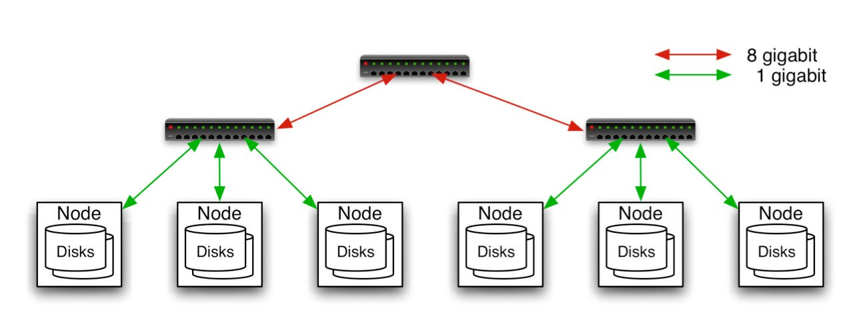
Typical Hadoop Cluster
40 nodes/rack, 1000-4000 nodes in cluster
1 GBps bandwidth in rack, 8 GBps out of rack
Node specs (Yahoo! terasort):
8 x 2.0 GHz cores, 8 GB RAM, 4 disks (= 4 TB?)

Slide 32
Typical Problems Solved by MR
Read a lot of data
Map: extract something you care about from each record
Shuffle and Sort
Reduce: aggregate, summarize, filter, transform
Write the results

Slide 33
Hadoop – MapReduce Paradigms
MapReduce is a framework used to process huge amounts of data in parallel.
MapReduce is a processing technique and a program model for distributed computing based on java.
The MapReduce algorithm has two tasks
Map
Reduce.
Map takes a set of data and converts it into another set of data.
Individual elements are broken down into tuples (key/value pairs)

Slide 34
MapReduce Paradigm
Programming model developed at Google
Sort/merge based distributed computing
Initially, it was intended for their internal search/indexing application, but now used extensively by more organizations (e.g., Yahoo, Amazon.com, IBM, etc.)
It is functional style programming (e.g., LISP) that is naturally parallelizable across a large cluster of workstations or PCS.
The underlying system takes care of the partitioning of the input data, scheduling the program’s execution across several machines, handling machine failures, and managing required inter-machine communication. (This is the key for Hadoop’s success)

Slide 35
Hadoop – MapReduce Paradigms
MapReduce program executes in three stages, namely map stage, shuffle stage, and reduce stage.
Map stage
The map or mapper’s job is to process the input data
The input file is passed to the mapper function line by line.
The mapper processes the data and creates several small chunks of data.
Reduce stage
This stage is the combination of the Shuffle stage and the Reduce stage.
The Reducer’s job is to process the data that comes from the mapper.
After processing, it produces a new set of output, which will be stored in the HDFS.

Slide 36
Hadoop – MapReduce Paradigms
During a MapReduce job, Hadoop sends the Map and Reduce tasks to the appropriate servers in the cluster.
The framework manages all the details of data-passing such as issuing tasks, verifying task completion, and copying data around the cluster between the nodes.
Most of the computing takes place on nodes with data on local disks that reduces the network traffic.
After completion of the given tasks, the cluster collects and reduces the data to form an appropriate result, and sends it back to the Hadoop server.

Slide 37
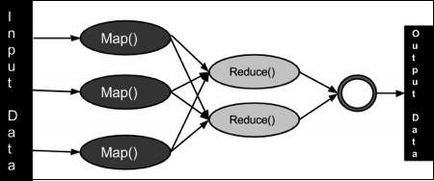
Hadoop – MapReduce Paradigms

Slide 38
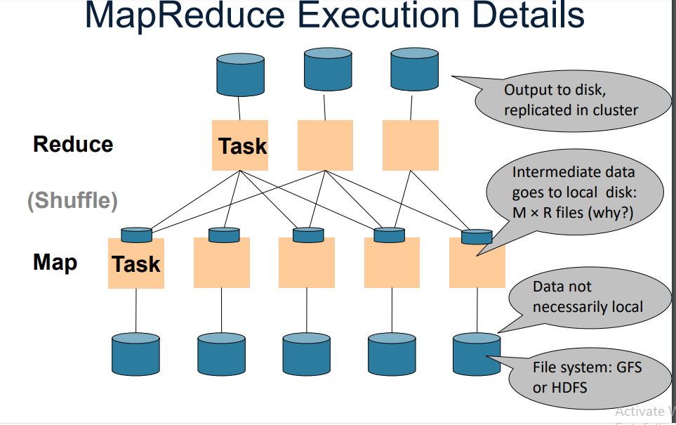

Slide 39
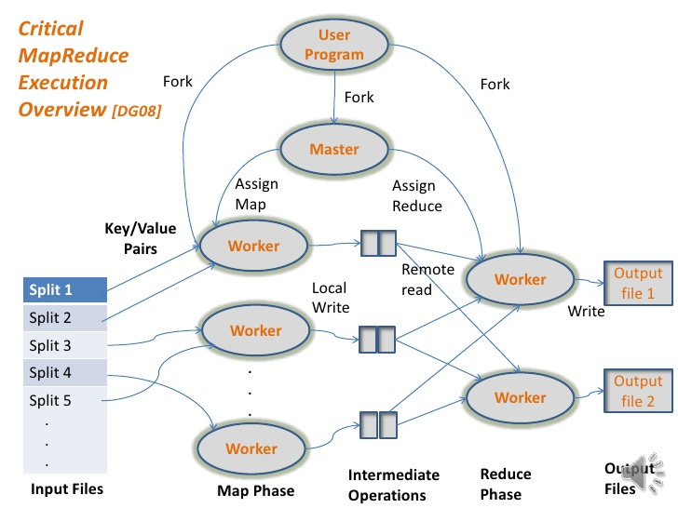
MapReduce Execution

Slide 40
Data Model
Files!
A file = a bag of (key, value) pairs
A MapReduce program:
Input: a bag of (inputkey, value) pairs
Output: a bag of (outputkey, value) pairs

Slide 41
Inputs and Outputs (Java Perspective)
The MapReduce framework operates on <key, value> pairs.
input to the job as a set of <key, value> pairs and produces a set of <key, value> pairs as the output of the job.
key and the value classes should be in serialized manner , so implement Writable interface.
The key classes have to implement the Writable-Comparable interface to facilitate sorting by the framework.
 | Input | Output
Map | <k1, v1> | list (<k2, v2>)
Reduce | <k2, list(v2)> | list (<k3, v3>)

Slide 42
Example MapReduce: To count the occurrences of words in the given set of documents
map(String key, String value):
// key: document name; value: document contents; map (k1,v1) → list(k2,v2)
for each word w in value: EmitIntermediate(w, "1");
(Example: If input string is (“Saibaba is God. I am I”), Map produces
{<“Saibaba”,1”>, <“is”, 1>, <“God”, 1>, <“I”,1>, <“am”,1>,<“I”,1>}
reduce(String key, Iterator values):
// key: a word; values: a list of counts; reduce (k2,list(v2)) → list(v2)
int result = 0;
for each v in values:
result += ParseInt(v);
Emit(AsString(result));
(Example: reduce(“I”, <1,1>) → 2)

Slide 43
How does MapReduce work?
The run time partitions the input and provides it to different Map instances;
Map (key, value) → (key’, value’)
The run time collects the (key’, value’) pairs and distributes them to several Reduce functions so that each Reduce function gets the pairs with the same key’.
Each Reduce produces a single (or zero) file output.
Map and Reduce are user written functions

Slide 44
Terminology
PayLoad − Applications implement the Map and the Reduce functions, and form the core of the job.
Mapper − Mapper maps the input key/value pairs to a set of intermediate key/value pair.
NamedNode − Node that manages the Hadoop Distributed File System (HDFS).
DataNode − Node where data is presented in advance before any processing takes place.
MasterNode − Node where JobTracker runs and which accepts job requests from clients.
SlaveNode − Node where Map and Reduce program runs.
JobTracker − Schedules jobs and tracks the assign jobs to Task tracker.
Task Tracker − Tracks the task and reports status to JobTracker.

Slide 45
Hadoop – MapReduce Paradigms
Job − A program is an execution of a Mapper and Reducer across a dataset.
Task − An execution of a Mapper or a Reducer on a slice of data.
Task Attempt − A particular instance of an attempt to execute a task on a SlaveNode.

Slide 46
Fault Tolerance
MapReduce handles fault tolerance by writing intermediate files to disk:
– Mappers write file to local disk
– Reducers read the files (=reshuffling); if the server fails, the reduce task is restarted on another server

Slide 47
Q&A
1.Why Map Reduce
Scale data processing over multiple computing nodes.
2. What is map reduce
Data-parallel programming model for clusters of commodity machines

